Slide 1
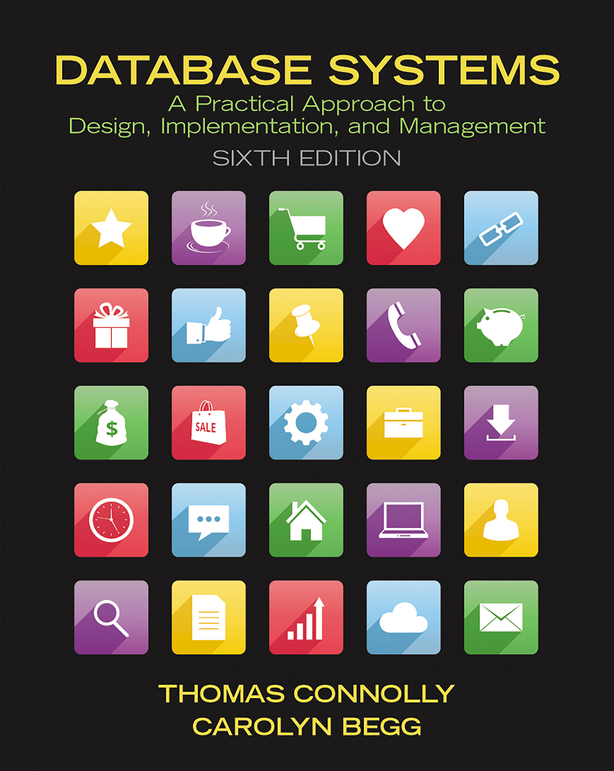
Database Systems: A Practical Approach to Design, Implementation, and Management
Sixth Edition
Chapter 24
Distributed D B M Ss – Concepts and Design
Copyright © 2015, 2010, 2005 Pearson Education, Inc. All Rights Reserved
Notes:
If this PowerPoint presentation contains mathematical equations, you may need to check that your computer has the following installed:
1) MathType Plugin
2) Math Player (free versions available)
3) NVDA Reader (free versions available)

Slide 2
Learning Objectives
24.1 Concepts.
24.2 Advantages and disadvantages of distributed databases.
24.3 Functions and architecture for a D D B M S.
24.4 Distributed database design.
24.5 Levels of transparency.
24.6 Comparison criteria for D D B M Ss.

Slide 3
Concepts (1 of 2)
Distributed Database
A logically interrelated collection of shared data (and a description of this data), physically distributed over a computer network.
Distributed D B M S
Software system that permits the management of the distributed database and makes the distribution transparent to users.

Slide 4
Concepts (2 of 2)
Collection of logically-related shared data.
Data split into fragments.
Fragments may be replicated.
Fragments/replicas allocated to sites.
Sites linked by a communications network.
Data at each site is under control of a D B M S.
D B M Ss handle local applications autonomously.
Each D B M S participates in at least one global application.

Slide 5
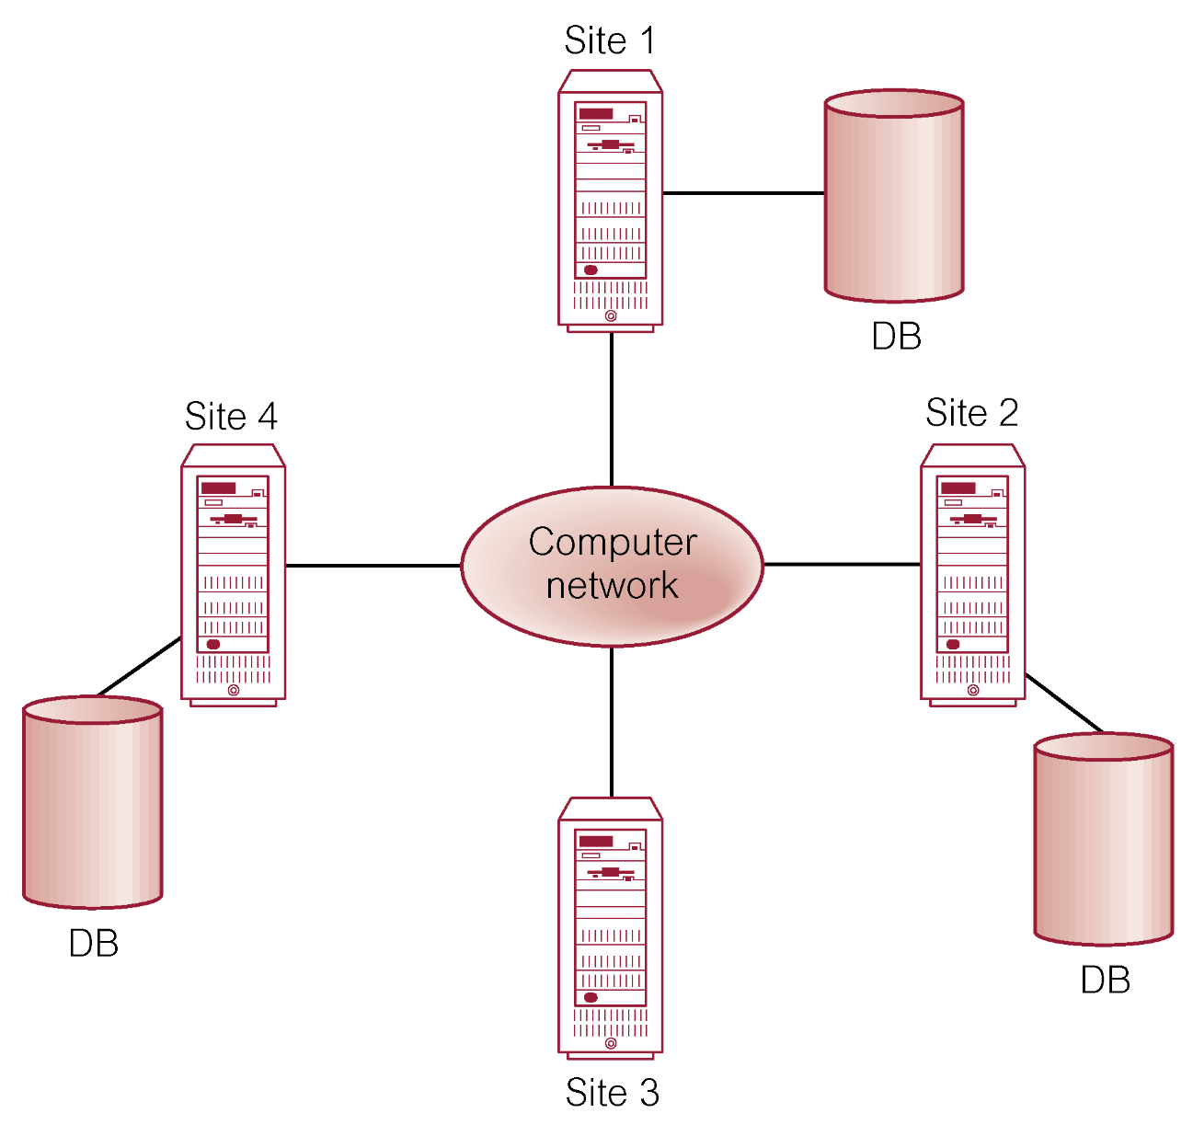
Distributed D B M S

Slide 6
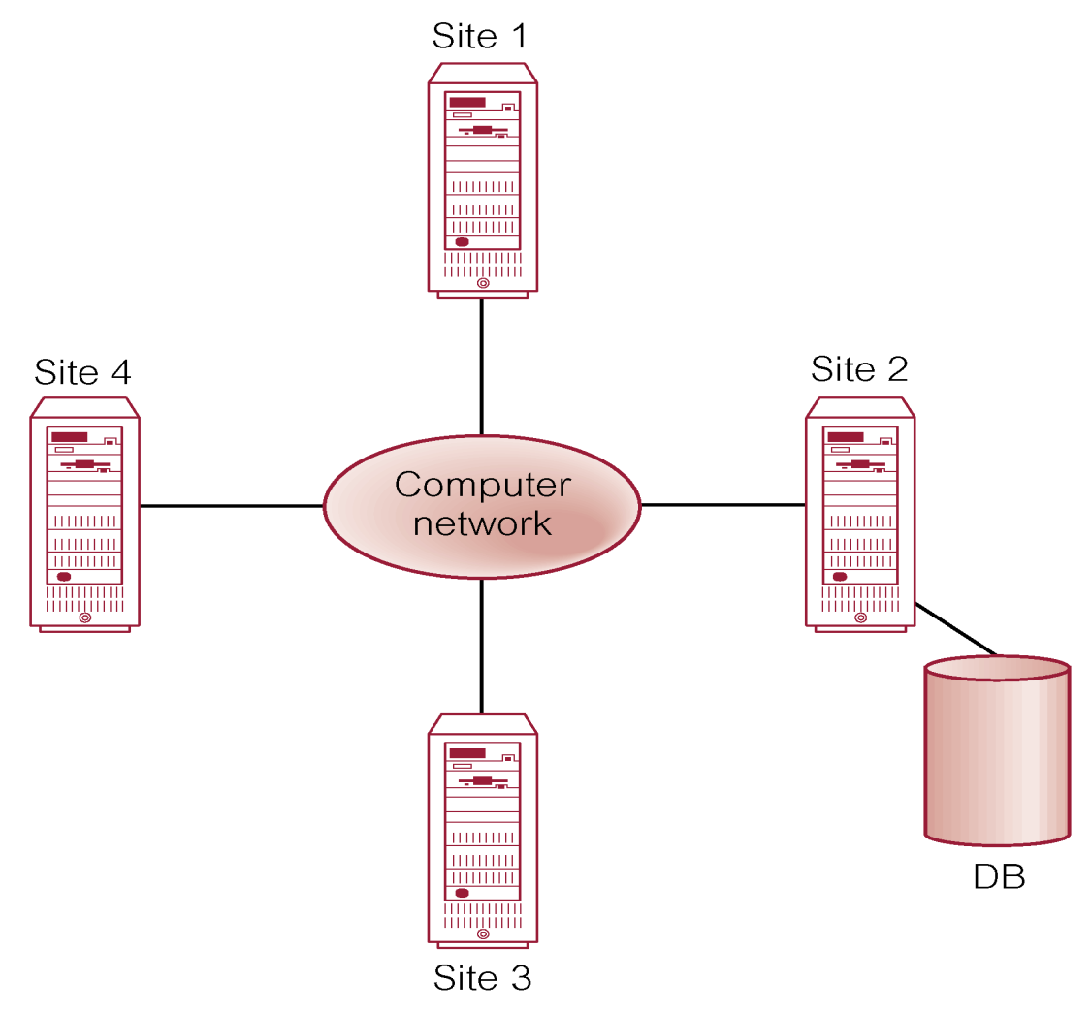
Distributed Processing
A centralized database that can be accessed over a computer network.

Slide 7
Parallel D B M S (1 of 3)
A D B M S running across multiple processors and disks designed to execute operations in parallel, whenever possible, to improve performance.
Based on premise that single processor systems can no longer meet requirements for cost-effective scalability, reliability, and performance.
Parallel D B M Ss link multiple, smaller machines to achieve same throughput as single, larger machine, with greater scalability and reliability.

Slide 8
Parallel D B M S (2 of 3)
Main architectures for parallel D B M Ss are:
Shared memory,
Shared disk,
Shared nothing.

Slide 9
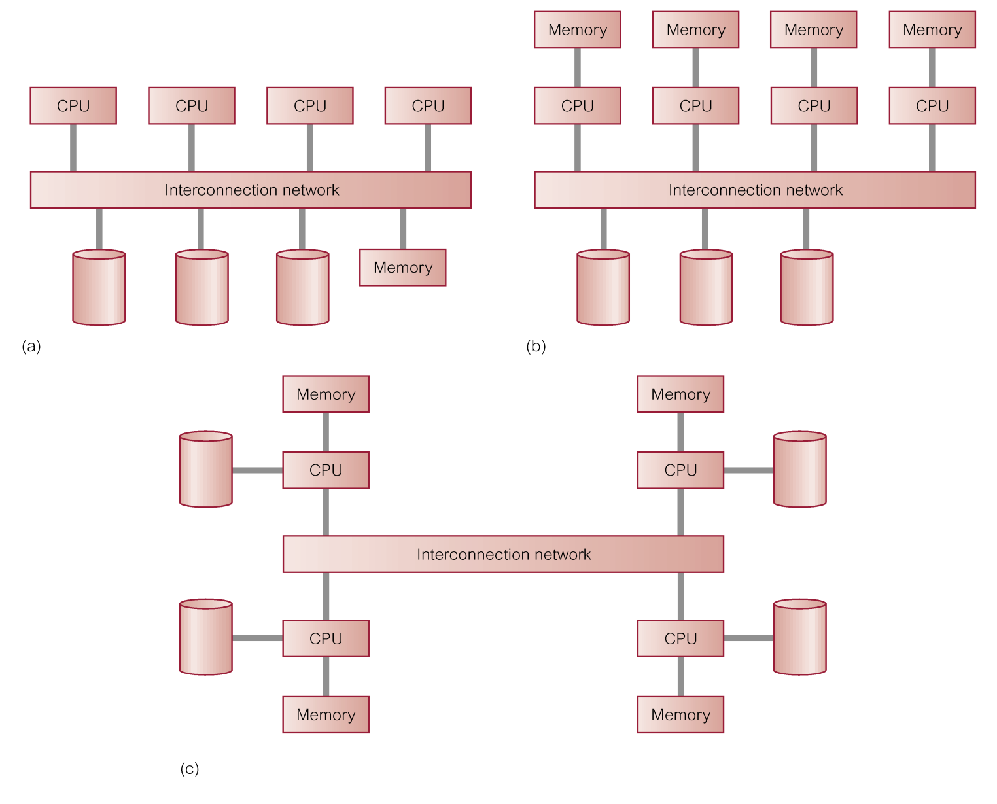
Parallel D B M S (3 of 3)
(a) shared memory
(b) shared disk
(c) shared nothing

Slide 10
Advantages of D D B M Ss
Reflects organizational structure
Improved shareability and local autonomy
Improved availability
Improved reliability
Improved performance
Economics
Modular growth

Slide 11
Disadvantages of D D B M Ss
Complexity
Cost
Security
Integrity control more difficult
Lack of standards
Lack of experience
Database design more complex

Slide 12
Types of D D B M S
Homogeneous D D B M S
Heterogeneous D D B M S

Slide 13
Homogeneous D D B M S
All sites use same D B M S product.
Much easier to design and manage.
Approach provides incremental growth and allows increased performance.

Slide 14
Heterogeneous D D B M S
Sites may run different D B M S products, with possibly different underlying data models.
Occurs when sites have implemented their own databases and integration is considered later.
Translations required to allow for:
Different hardware.
Different D B M S products.
Different hardware and different D B M S products.
Typical solution is to use gateways.

Slide 15
Open Database Access and Interoperability (1 of 2)
Open Group formed a Working Group to provide specifications that will create a database infrastructure environment where there is:
Common S Q L A P I that allows client applications to be written that do not need to know vendor of D B M S they are accessing.
Common database protocol that enables D B M S from one vendor to communicate directly with D B M S from another vendor without the need for a gateway.
A common network protocol that allows communications between different D B M Ss.

Slide 16
Open Database Access and Interoperability (2 of 2)
Most ambitious goal is to find a way to enable transaction to span D B M Ss from different vendors without use of a gateway.
Group has now evolved into D B I O P Consortium and are working in version 3 of D R D A (Distributed Relational Database Architecture) standard.

Slide 17
Multidatabase System (M D B S)
D D B M S in which each site maintains complete autonomy.
D B M S that resides transparently on top of existing database and file systems and presents a single database to its users.
Allows users to access and share data without requiring physical database integration.
Unfederated M D B S (no local users) and federated M D B S

Slide 18
Overview of Networking (1 of 2)
Network - Interconnected collection of autonomous computers, capable of exchanging information.
Local Area Network (LAN) intended for connecting computers at same site.
Wide Area Network (WAN) used when computers or LANs need to be connected over long distances.
WAN relatively slow and less reliable than LANs. D D B M S using LAN provides much faster response time than one using WAN.

Slide 19
Overview of Networking (2 of 2)
WAN | LAN
Distances up to thousands of kilometres | Distances up to a few kilometers (Wireless LAN, or WLAN, is of the order of tens of meters)
Link autonomous computers | Link computers that cooperate in distributed applications
Network managed by independent organization (using telephone or satellite links) | Network managed by users (using privately owned cables)
Data rate up to 33.6 kilobit/second (dial-up via modem), 45 Megabit/second (T3 circuit) | Data rate up to 2500 Megabit/second (A T M). 100 gigabyte (100 million bits per second) for Ethernet. WLAN is typically –108 Megabit/second, although 802.11n standard is 600 Megabits/second.
Complex protocol | Simpler protocol
Use point-to-point routing | Use broadcast routing
Use irregular topology | Use bus or ring topology
error rate about 1 in 10 to the fifth power | error rate about 1 per 10 to the ninth power.

Slide 20
Functions of a D D B M S
Expect D D B M S to have at least the functionality of a D B M S.
Also to have following functionality:
Extended communication services.
Extended Data Dictionary.
Distributed query processing.
Extended concurrency control.
Extended recovery services.

Slide 21
Reference Architecture for D D B M S (1 of 2)
Due to diversity, no accepted architecture equivalent to A N S I/S P A R C3-level architecture.
A reference architecture consists of:
Set of global external schemas.
Global conceptual schema (G C S).
Fragmentation schema and allocation schema.
Set of schemas for each local D B M S conforming to 3-level A N S I/S P A R C.
Some levels may be missing, depending on levels of transparency supported.

Slide 22
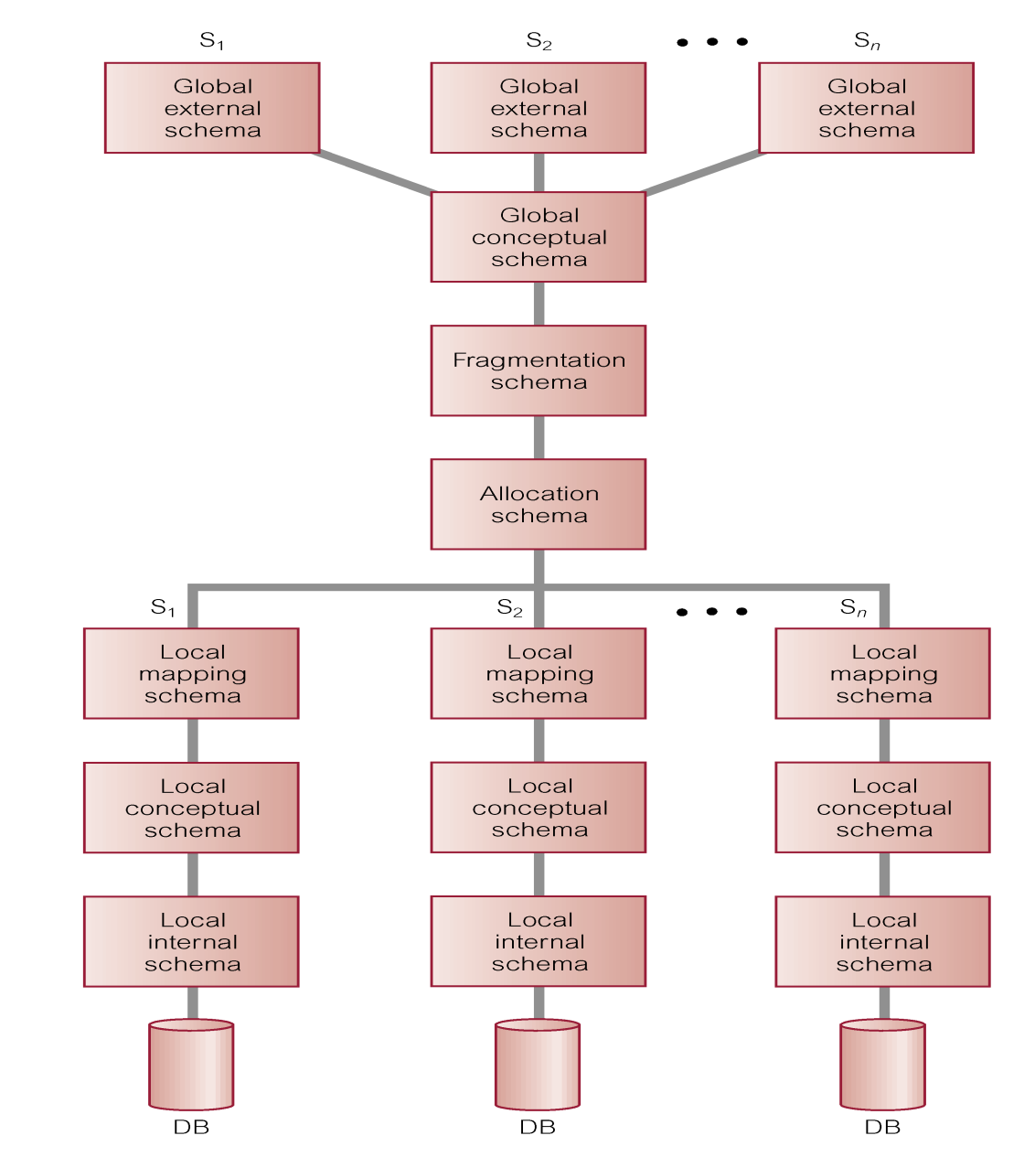
Reference Architecture for D D B M S (2 of 2)

Slide 23
Reference Architecture for M D B S
In D D B M S, G C S is union of all local conceptual schemas.
In F M D B S, G C S is subset of local conceptual schemas (L C S), consisting of data that each local system agrees to share.
G C S of tightly coupled system involves integration of either parts of L C Ss or local external schemas.
F M D B S with no G C S is called loosely coupled.

Slide 24
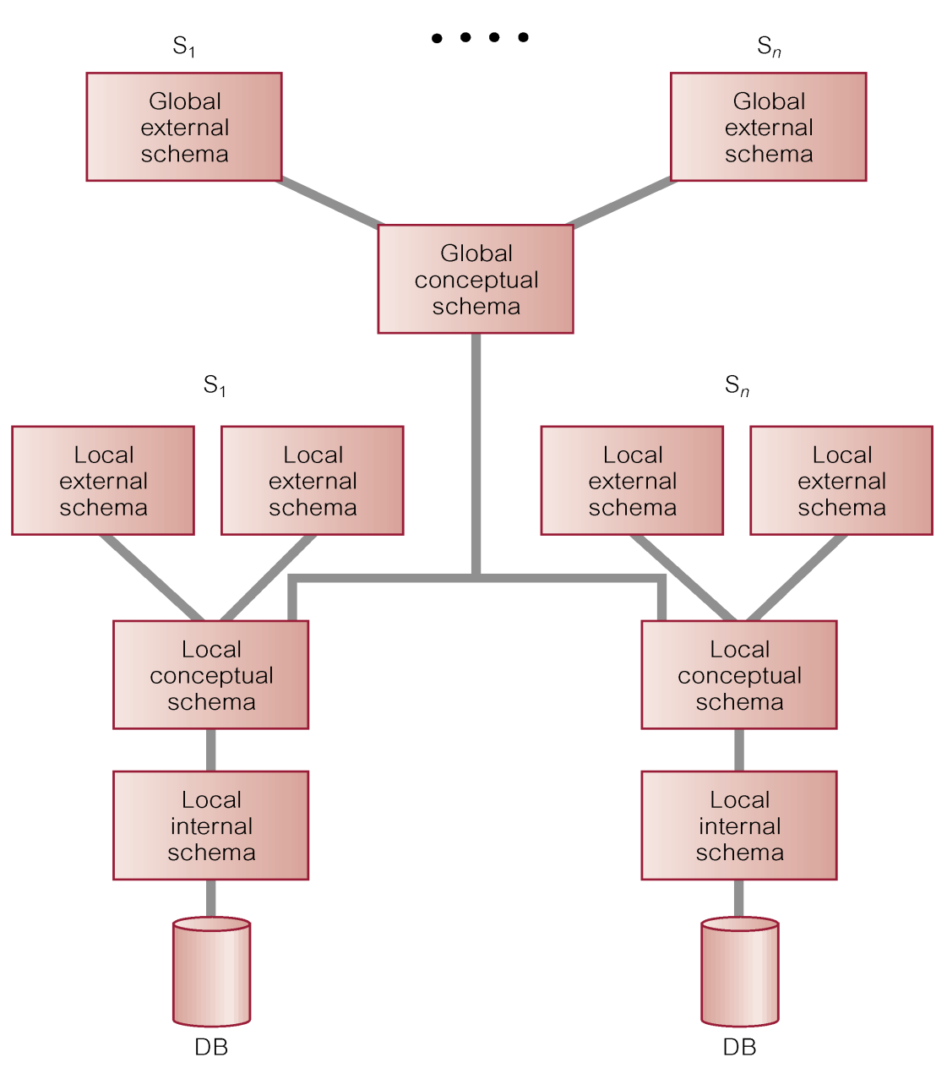
Reference Architecture for Tightly-Coupled F M D B S

Slide 25
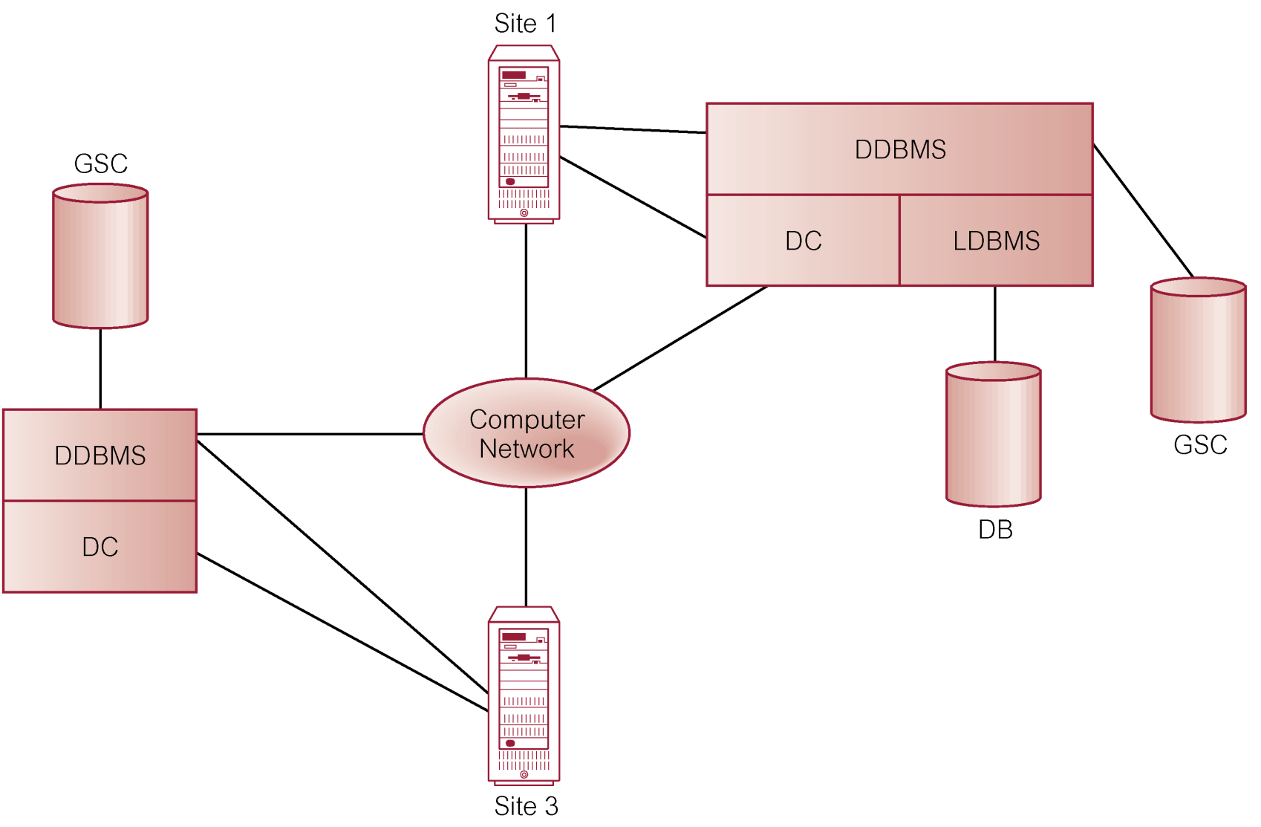
Components of a D D B M S

Slide 26
Distributed Database Design (1 of 2)
Three key issues:
Fragmentation,
Allocation,
Replication.

Slide 27
Distributed Database Design (2 of 2)
Fragmentation
Relation may be divided into a number of sub-relations, which are then distributed.
Allocation
Each fragment is stored at site with “optimal” distribution.
Replication
Copy of fragment may be maintained at several sites.

Slide 28
Fragmentation (1 of 2)
Definition and allocation of fragments carried out strategically to achieve:
Locality of Reference.
Improved Reliability and Availability.
Improved Performance.
Balanced Storage Capacities and Costs.
Minimal Communication Costs.
Involves analyzing most important applications, based on quantitative/qualitative information.

Slide 29
Fragmentation (2 of 2)
Quantitative information may include:
frequency with which an application is run;
site from which an application is run;
performance criteria for transactions and applications.
Qualitative information may include transactions that are executed by application, type of access (read or write), and predicates of read operations.

Slide 30
Data Allocation (1 of 2)
Four alternative strategies regarding placement of data:
Centralized,
Partitioned (or Fragmented),
Complete Replication,
Selective Replication.

Slide 31
Data Allocation (2 of 2)
Centralized: Consists of single database and D B M S stored at one site with users distributed across the network.
Partitioned: Database partitioned into disjoint fragments, each fragment assigned to one site.
Complete Replication: Consists of maintaining complete copy of database at each site.
Selective Replication: Combination of partitioning, replication, and centralization.

Slide 32
Comparison of Strategies for Data Distribution
Blank | Locality of reference | Reliability and availability | Performance | Storage costs | Communication costs
Centralized | Lowest | Lowest | Unsatisfactory | Lowest | Highest
Fragmented | High superscript a | Low for item; high for system | Satisfactory superscript a | Lowest | Low superscript a
Complete replication | Highest | Highest | Best for read | Highest | High for update; low for read
Selective replication | High superscript a | Low for item; high for system | Satisfactory superscript a | Average | Low superscript a
subject to good design.

Slide 33
Why Fragment? (1 of 3)
Usage
Applications work with views rather than entire relations.
Efficiency
Data is stored close to where it is most frequently used.
Data that is not needed by local applications is not stored.

Slide 34
Why Fragment? (2 of 3)
Parallelism
With fragments as unit of distribution, transaction can be divided into several subqueries that operate on fragments.
Security
Data not required by local applications is not stored and so not available to unauthorized users.

Slide 35
Why Fragment? (3 of 3)
Disadvantages
Performance,
Integrity.

Slide 36
Correctness of Fragmentation (1 of 3)
Three correctness rules:
Completeness,
Reconstruction,
Disjointness.

Slide 37
Correctness of Fragmentation (2 of 3)
Completeness
If relation R is decomposed into fragments
each data item that can be found in R must appear in at least one fragment.
Reconstruction
Must be possible to define a relational operation that will reconstruct R from the fragments.
Reconstruction for horizontal fragmentation is Union operation and Join for vertical.

Slide 38
Correctness of Fragmentation (3 of 3)
Disjointness
If data item d_{i} appears in fragment R_{i}, then it should not appear in any other fragment.
Exception: vertical fragmentation, where primary key attributes must be repeated to allow reconstruction.
For horizontal fragmentation, data item is a tuple.
For vertical fragmentation, data item is an attribute.

Slide 39
Types of Fragmentation
Four types of fragmentation:
Horizontal,
Vertical,
Mixed,
Derived.
Other possibility is no fragmentation:
If relation is small and not updated frequently, may be better not to fragment relation.

Slide 40

Horizontal and Vertical Fragmentation

Slide 41
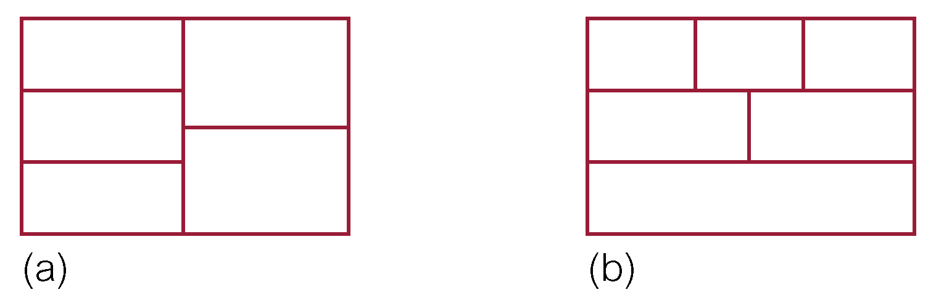
Mixed Fragmentation (1 of 2)

Slide 42
Horizontal Fragmentation (1 of 2)
Consists of a subset of the tuples of a relation.
Defined using Selection operation of relational algebra:
For example:

Slide 43
Horizontal Fragmentation (2 of 2)
This strategy is determined by looking at predicates used by transactions.
Involves finding set of minimal (complete and relevant) predicates.
Set of predicates is complete, if and only if, any two tuples in same fragment are referenced with same probability by any application.
Predicate is relevant if there is at least one application that accesses fragments differently.

Slide 44
Vertical Fragmentation
Consists of a subset of attributes of a relation.
Defined using Projection operation of relational algebra:
For example:
Determined by establishing affinity of one attribute to another.

Slide 45
Mixed Fragmentation (2 of 2)
Consists of a horizontal fragment that is vertically fragmented, or a vertical fragment that is horizontally fragmented.
Defined using Selection and Projection operations of relational algebra:

Slide 46
Example - Mixed Fragmentation

Slide 47
Derived Horizontal Fragmentation (1 of 2)
A horizontal fragment that is based on horizontal fragmentation of a parent relation.
Ensures that fragments that are frequently joined together are at same site.
Defined using Semijoin operation of relational algebra:

Slide 48
Example - Derived Horizontal Fragmentation
Could use derived fragmentation for Property:

Slide 49
Derived Horizontal Fragmentation (2 of 2)
If relation contains more than one foreign key, need to select one as parent.
Choice can be based on fragmentation used most frequently or fragmentation with better join characteristics.

Slide 50
Distributed Database Design Methodology
Use normal methodology to produce a design for the global relations.
Examine topology of system to determine where databases will be located.
Analyze most important transactions and identify appropriateness of horizontal/vertical fragmentation.
Decide which relations are not to be fragmented.
Examine relations on 1 side of relationships and determine a suitable fragmentation schema. Relations on many side may be suitable for derived fragmentation.

Slide 51
Transparencies in a D D B M S (1 of 2)
Distribution Transparency
Fragmentation Transparency
Location Transparency
Replication Transparency
Local Mapping Transparency
Naming Transparency

Slide 52
Transparencies in a D D B M S (2 of 2)
Transaction Transparency
Concurrency Transparency
Failure Transparency
Performance Transparency
D B M S Transparency
D B M S Transparency

Slide 53
Distribution Transparency
Distribution transparency allows user to perceive database as single, logical entity.
If D D B M S exhibits distribution transparency, user does not need to know:
data is fragmented (fragmentation transparency),
location of data items (location transparency),
otherwise call this local mapping transparency.
With replication transparency, user is unaware of replication of fragments.

Slide 54
Naming Transparency (1 of 3)
Each item in a D D B must have a unique name.
D D B M S must ensure that no two sites create a database object with same name.
One solution is to create central name server. However, this results in:
loss of some local autonomy;
central site may become a bottleneck;
low availability; if the central site fails, remaining sites cannot create any new objects.

Slide 55
Naming Transparency (2 of 3)
Alternative solution - prefix object with identifier of site that created it.
For example, Branch created at site S₁ might be named S1.BRANCH.
Also need to identify each fragment and its copies.
Thus, copy 2 of fragment 3 of Branch created at site S ₁ might be referred to as S1.BRANCH.F3.C2.
However, this results in loss of distribution transparency.

Slide 56
Naming Transparency (3 of 3)
An approach that resolves these problems uses aliases for each database object.
Thus, S1.BRANCH.F3.C2 might be known as LocalBranch by user at site S ₁.
D D B M S has task of mapping an alias to appropriate database object.

Slide 57
Transaction Transparency
Ensures that all distributed transactions maintain distributed database’s integrity and consistency.
Distributed transaction accesses data stored at more than one location.
Each transaction is divided into number of subtransactions, one for each site that has to be accessed.
D B M S must ensure the indivisibility of both the global transaction and each of the subtransactions.

Slide 58
Example - Distributed Transaction
T prints out names of all staff, using schema defined above as S ₁, S ₂, S ₂₁, S ₂₂, and S ₂₃. Define three subtransactions T _{S3}, T _{S5}, and T _{S7} to represent agents at sites 3, 5, and 7.
Time | T_{S3} | T_{S5} | T_{S7}
t₁ | begin_transaction | begin_transaction | begin_transaction
t₂ | read(f Name, l Name) | read(f Name, l Name) | read(f Name, l Name)
t₃ | print(f Name, l Name) | print(f Name, l Name) | print(f Name, l Name)
t₄ | end_transaction | end_transaction | end_transaction

Slide 59
Concurrency Transparency
All transactions must execute independently and be logically consistent with results obtained if transactions executed one at a time, in some arbitrary serial order.
Same fundamental principles as for centralized D B M S.
D D B M S must ensure both global and local transactions do not interfere with each other.
Similarly, D D B M S must ensure consistency of all subtransactions of global transaction.

Slide 60
Classification of Transactions (1 of 2)
In I B M’s Distributed Relational Database Architecture (D R D A), four types of transactions:
Remote request
Remote unit of work
Distributed unit of work
Distributed request.

Slide 61
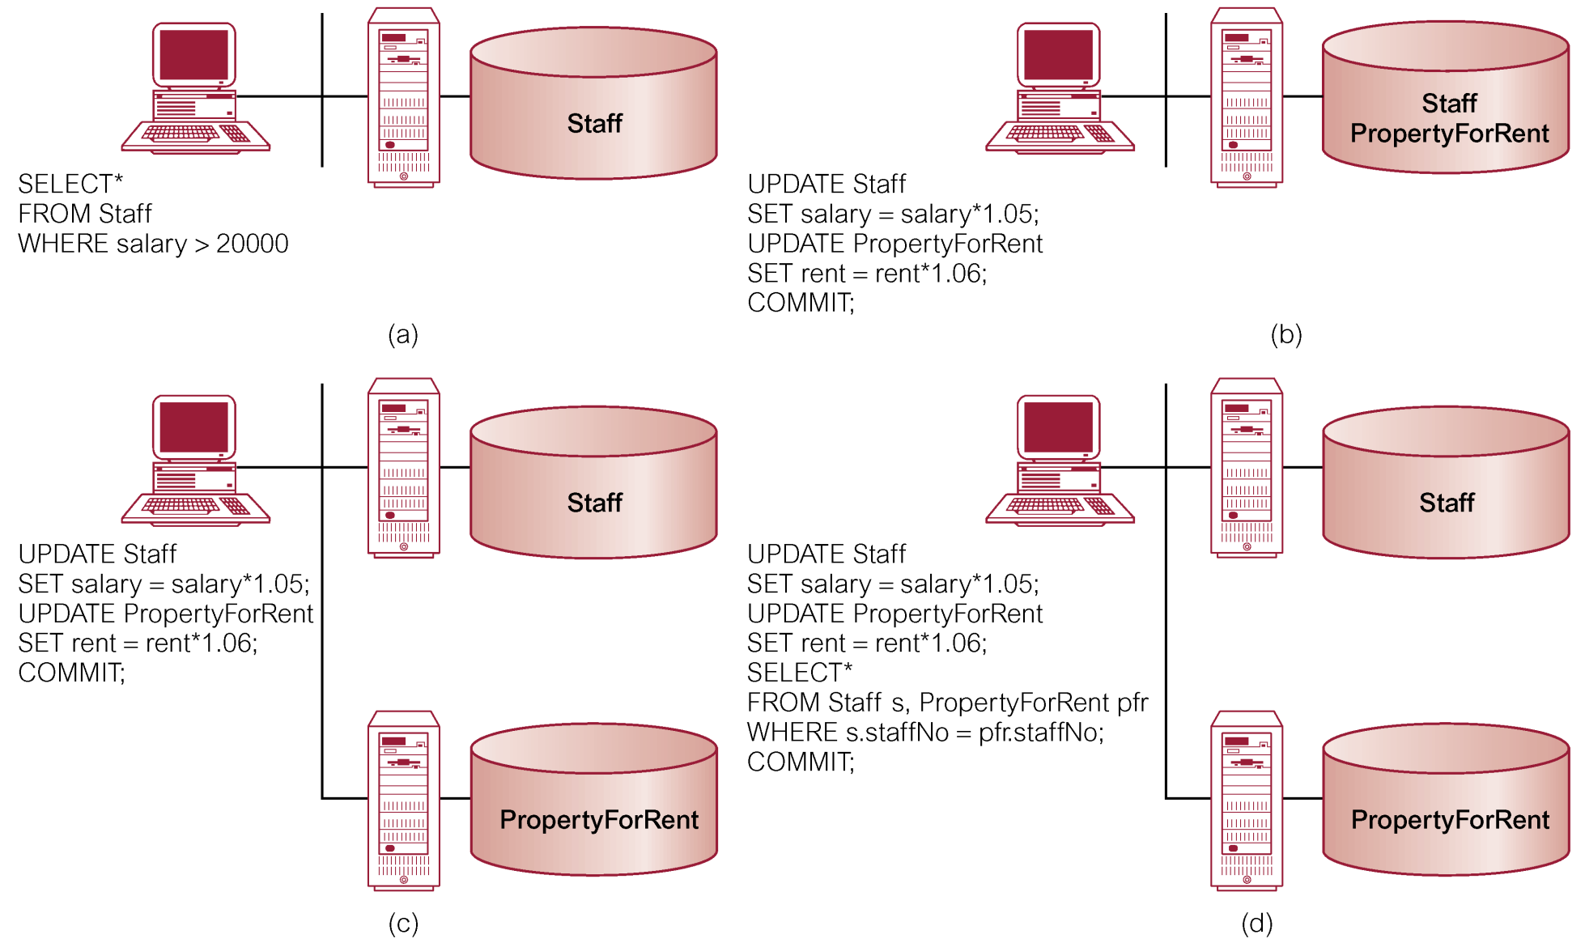
Classification of Transactions (2 of 2)

Slide 62
Concurrency Transparency (1 of 2)
Replication makes concurrency more complex.
If a copy of a replicated data item is updated, update must be propagated to all copies.
Could propagate changes as part of original transaction, making it an atomic operation.
However, if one site holding copy is not reachable, then transaction is delayed until site is reachable.

Slide 63
Concurrency Transparency (2 of 2)
Could limit update propagation to only those sites currently available. Remaining sites updated when they become available again.
Could allow updates to copies to happen asynchronously, sometime after the original update. Delay in regaining consistency may range from a few seconds to several hours.

Slide 64
Failure Transparency
D D B M S must ensure atomicity and durability of global transaction.
Means ensuring that subtransactions of global transaction either all commit or all abort.
Thus, D D B M S must synchronize global transaction to ensure that all subtransactions have completed successfully before recording a final COMMIT for global transaction.
Must do this in presence of site and network failures.

Slide 65
Performance Transparency (1 of 3)
D D B M S must perform as if it were a centralized D B M S.
D D B M S should not suffer any performance degradation due to distributed architecture.
D D B M S should determine most cost-effective strategy to execute a request.

Slide 66
Performance Transparency (2 of 3)
Distributed Query Processor (D Q P) maps data request into ordered sequence of operations on local databases.
Must consider fragmentation, replication, and allocation schemas.
D Q P has to decide:
which fragment to access;
which copy of a fragment to use;
which location to use.

Slide 67
Performance Transparency (3 of 3)
D Q P produces execution strategy optimized with respect to some cost function.
Typically, costs associated with a distributed request include:
I/O cost;
C P U cost;
communication cost.

Slide 68
Performance Transparency - Example (1 of 3)
Property(prop N o, city) | 10000 records in London
Client(client N o,max Price) | 100000 records in Glasgow
Viewing(prop N o, client No) | 1000000 records in London
SELECT p.prop N o
FROM Property p INNER JOIN
(Client c INNER JOIN Viewing v ON c.client N o = v.client N o)
ON p.prop N o = v.prop N o
WHERE p.city = ‘Aberdeen’ AND c.max Price > 200000;

Slide 69
Performance Transparency - Example (2 of 3)
Assume:
Each tuple in each relation is 100 characters long.
10 renters with maximum price greater than £200,000.
100 000 viewings for properties in Aberdeen.
Computation time negligible compared to communication time.

Slide 70
Performance Transparency - Example (3 of 3)
Strategy | Time
(1) Move the Client relation to London and process query there: | 16.7 minutes
(2) Move the Property and Viewing relations to Glasgow and process query there | 28 hours
(3) Join the Property and Viewing relations at London, select tuples for Aberdeen properties and, for each of these in turn, check at Glasgow to determine is associated maxPrice > £200,000 | 2.3 days
(4) Select clients with maxPrice > £200,000 at Glasgow and, for each one found, check at London for a viewing involving that client and an Aberdeen property | 20 seconds
(5) Join Property and Viewing relations at London, select Aberdeen properties, project result over propertyNo and clientNo, and move this result to Glasgow for matching with maxPrice > £200,000 | 16.7 minutes
(6) Select clients with maxPrice > £200,000 at Glasgow and move the result to London for matching with Aberdeen properties | 1 second

Slide 71
Date’s 12 Rules for a D D B M S (1 of 2)
0. Fundamental Principle
To the user, a distributed system should look exactly like a nondistributed system.
1. Local Autonomy
2. No Reliance on a Central Site
3. Continuous Operation
4. Location Independence
5. Fragmentation Independence
6. Replication Independence

Slide 72
Date’s 12 Rules for a D D B M S (2 of 2)
7. Distributed Query Processing
8. Distributed Transaction Processing
9. Hardware Independence
10. Operating System Independence
11. Network Independence
12. Database Independence
Last four rules are ideals.

